Slide 1
Camera“LookAt”
WorldUp
<0,1,0>
TargetPos
Y
CameraPos
ViewDir
Z
X
ViewDir = TargetPos – CameraPos
But Z is the opposite directions so we will use...
ViewDir = CameraPos – TargetPos
Z = normalize( ViewDir )
X = WorldUp cross Z
X = normalize( X )
Y = Z cross X
Y = normalize( Y )
Copy X, Y, Z vectors into Matrix X,Y,Z axis columns

Slide 2
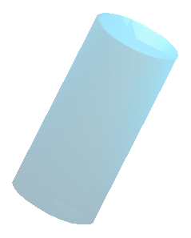
Cylinder to Point Collision
ProjPt
Given Cylinder and Test Point
base point = Bpt
cylinder normal = N
radius = R
length = L
test point = Tpt
L
Tpt
V
N
R
D
N'
Create vector from base point
to the test point
V = Tpt – Bpt
Compute the dot product of vector N and V and compare against 0 and length to determine if the test point falls within the bottom and top of the cylinder
D = N dot V : if ( D < 0 || D > L ) return false ( no collision )
Scale N by D (this completes vector projection N'=N(N dot V))
N' = D(N)
Add N' to base point to find test point projected into the cylinder
ProjPt = Bpt + N'
Compute distance between ProjPt and Tpt and compare to radius
if ( Distance( ProjPt, Tpt ) < radius ) return true ( collision )
Bpt

Slide 3


Sphere to plane – no collision
Cpt
Given Plane and Test Sphere
plane normal = N
plane point = Ppt
sphere center = Cpt
radius = R
R
N
V
N'
D
Create vector from plane point
to the sphere center point
V = Cpt – Ppt
Compute the dot product of vector N and V, then distance from the sphere center of the plane and compare to radius to find possible collision
D = N dot V
if ( D > R ) return false ( no collision )
If D < R then collision has occurred...
Ppt

Slide 4
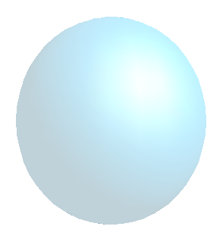
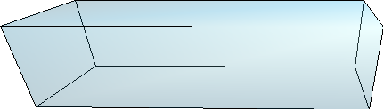
Sphere to plane – collision
Given Plane and Test Sphere
plane normal = N
plane point = Ppt
sphere center = Cpt
radius = R
N
Cpt
Ppt
V
D
R
N'
R-D
Create vector from plane point
to the sphere center point
V = Cpt – Ppt
Compute the dot product of vector N and V, then distance from the sphere center of the plane and compare to radius to find possible collision
D = N dot V
if ( D > R ) return false ( no collision )
Since D < R there is collision. To correct, the sphere center must be moved away from the plane. The direction is in normal, the magnitude is R-D.
N' = scale N by R-D
Cpt' = Cpt + N'

